Slide 1

Movie Recommendation System
Under the Guidance of
Prof. Nimbalkar S.
Karale Pratik Khaire Preeti
Rushikesh Shinde Neha Kamble

Slide 2
Introduction
Recommendation systems are becoming really important in today’s extremely busy world. People are always short on time with the huge amounts of tasks they need to finish it in the limited 24 hours. Therefore, the recommendation systems are important as they help them make the right choices, without having to expend their thinking resources. The purpose of a recommendation system basically is to search for content that would be interesting to an individual. Moreover, it involves a number of factors to create personalized lists of useful and interesting content specific to each user/individual.
Recommendation systems are Artificial Intelligence based algorithms that scan through all possible options and create a customized list of items that are interesting and relevant to an individual. These results are based on their profile, search/browsing history, what other people with similar interest are watching, and how likely are you to watch those movies. This is achieved through predictive modeling and heuristics with the data available.

Slide 3
Objective
The Movie Recommendation System provides a mechanism to help users categorize users with similar interests. Basically the purpose of a recommendation system is to search for material that will be interesting toa person. Moreover, it involves a number of factors to create personalized lists of useful and interesting content specific to each user/individual.

Slide 4
Problem Statement
For building a recommender system, we face several different problems. Currently there are a lot of recommender systems based on the user information, so what should we do if the website has not gotten enough users. After that, we will solve the representation of a movie, which is how a system can understand a movie. That is the precondition for comparing similarity between two movies. Movie features such as genre, actor and director is a way that can categorize movies.
What kind of movie features can be used for the recommender system.
How to calculate the similarity between two movies.

Slide 5
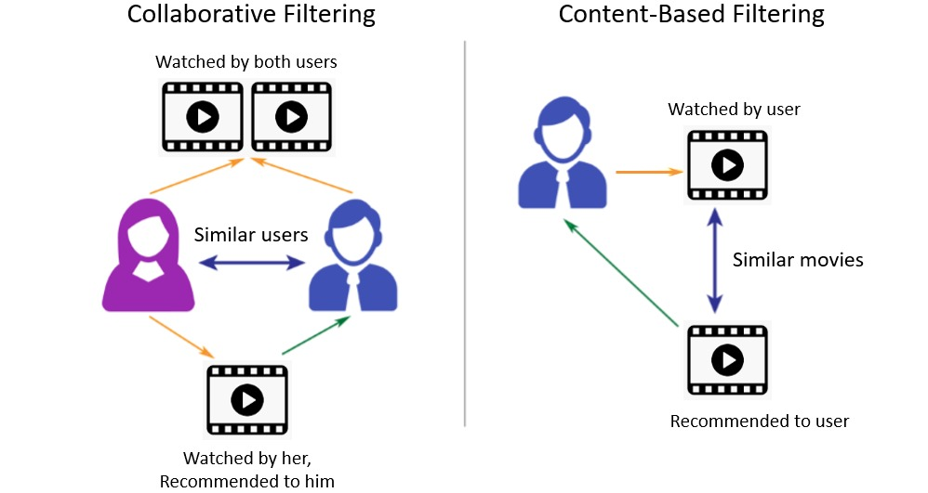
Theory
Types of Recommendation Systems:
1. Content-Based Recommendation System
2. Collaborative Recommendation System
We have implemented Content Based Movie Recommendation System.
A Content-Based Recommender System is one that follows a content-based filtration method to generate recommendations to the user. Content-Based filtration is mainly focused on recommending similar products to the user based on their history.

Slide 6
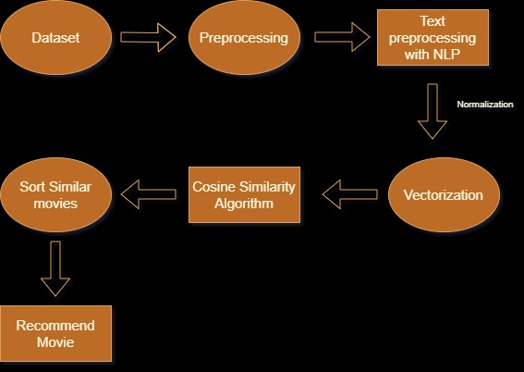
Proposed System

Slide 7
System Architecture
Dataset
We have downloaded dataset from Kaggle.com with 5000 movies data.
Data pre-processing
Data Loading
Data Viewing
Data Cleaning
NLP algorithm
In Machine Learning Natural language processing (NLP) is a field in which computers understand, analyze, and derive meaning from the provided language or human language in a smart and useful and effective way. By using NLP, developers can learn, organize and structure knowledge which will help them to perform tasks such as automatic summarization , translation, named entity recognition, relationship extraction, speech recognition, and topic segmentation and many their task can be performed using NLP.

Slide 8
System Architecture
Content-based filtering
Content-based filtering Content-based filtering -Content based Filtering is to make recommendations based on similar products/and services according to their attributes
Finding Similarity
Create vector representation for Bag_of_words, and create the similarity matrix The recommender model can only read and compare a vector (matrix) with another, so we need to convert the ‘Bag_of_words’ into vector representation using Count Vectorizer, which is a simple frequency counter for each word in the ‘Bag_of_words’ column. Once we have the matrix containing the count for all words, we can apply the cosine similarity function to compare similarities between movies.

Slide 9
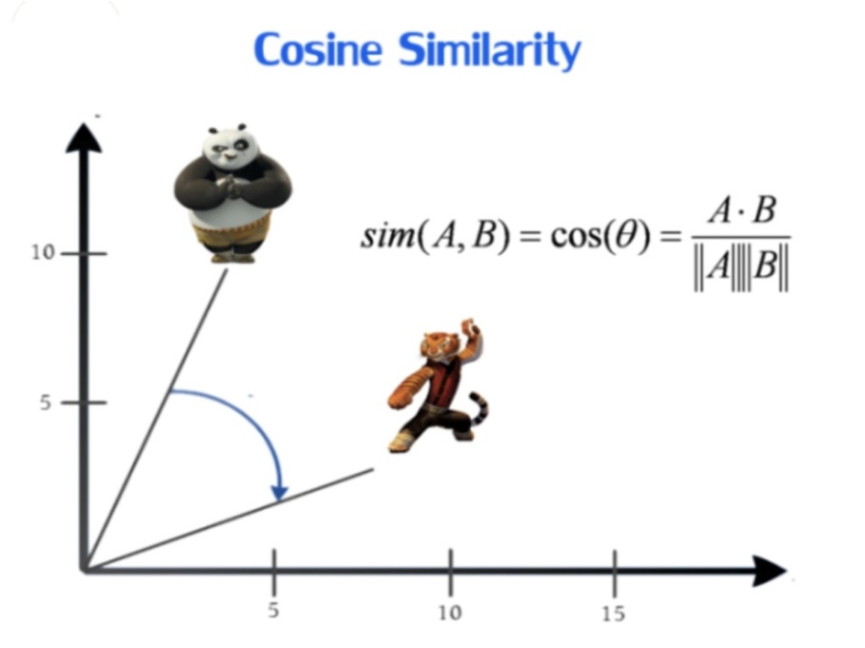
System Architecture
Cosine Similarity
Cosine similarity is a metric used to measure how similar two items are. Mathematically, it measures the cosine of the angle between two vectors projected in a multi-dimensional space. The output value ranges from 0–1. 0 means no similarity, where as 1 means that both the items are 100% similar.

Slide 10
Conclusion
The model has recommended vary similar movies. From my “domain knowledge”, We can see some similarities mainly based on directors, actor’s and other plot’s. We trained and tested the recommendation system. The accuracy rate is 80%. The movie recommender system provides very good prediction rate and is more reliable then the recommendation system based on collaborative filtering algorithm.

Slide 11
Reference
International Research Journal of Engineering and Technology (IRJET)
Volume: 07 Issue: 06 | June 2020
www.TechLearn.com
www.ScalarAcademy.com
www.Kaggle.com

